Slide 1
X

Slide 2
10 20 30 40 50 60 70 80 90 100
10
20
30
40
50
60
70
80
90
100

Slide 3
Puzzles

Slide 4
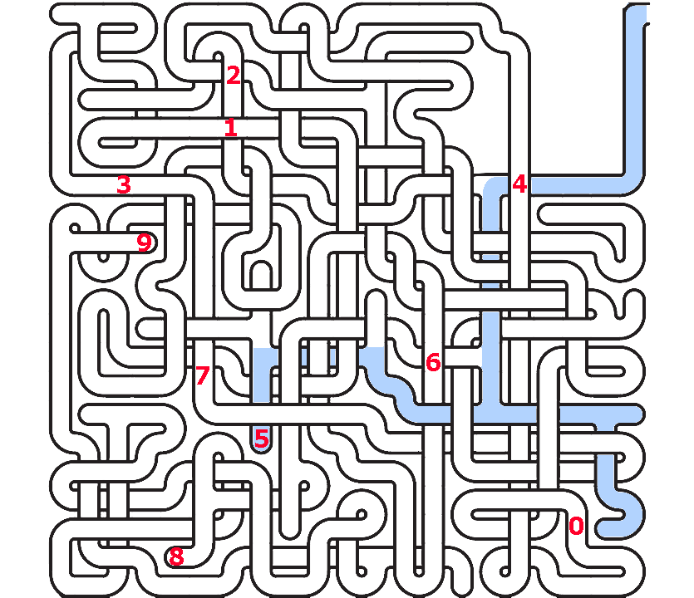

Slide 5
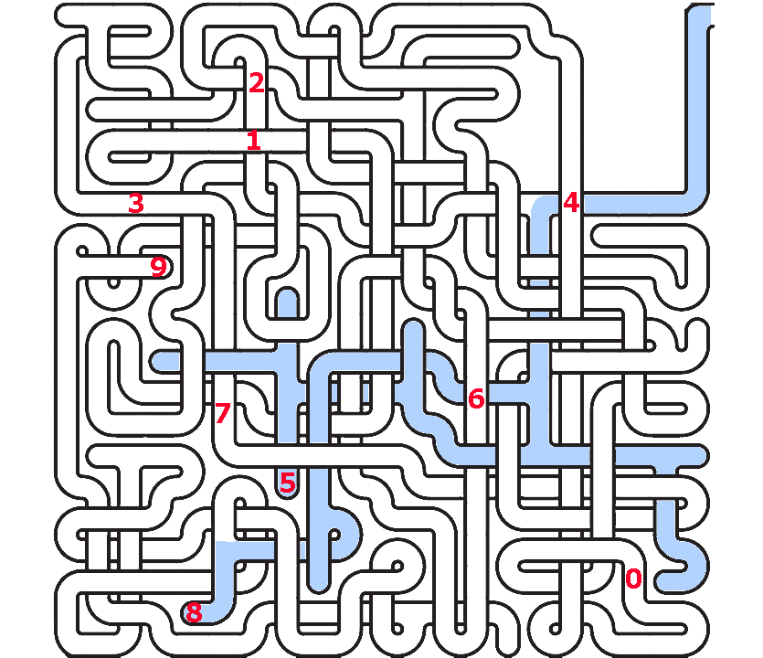

Slide 6
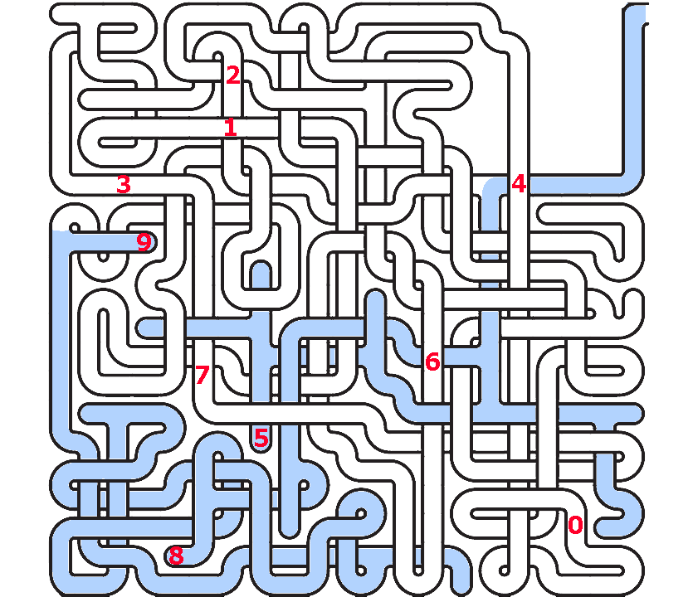

Slide 7
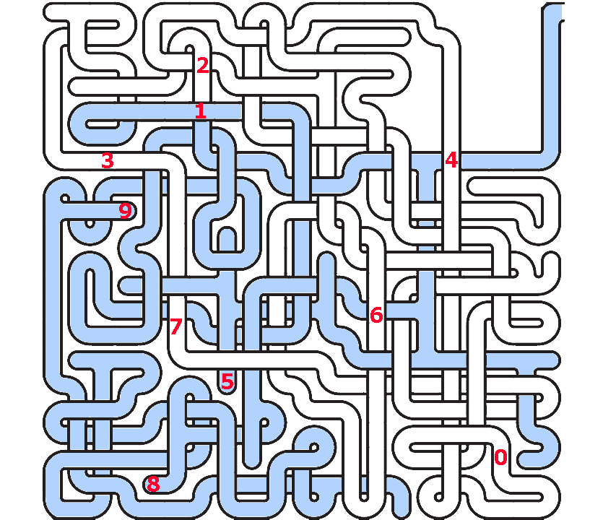

Slide 8
The Stables
https://sketchfab.com/3d-models/the-stables-82abdb57429b4074a9b42eb6f74eeb49

Slide 9
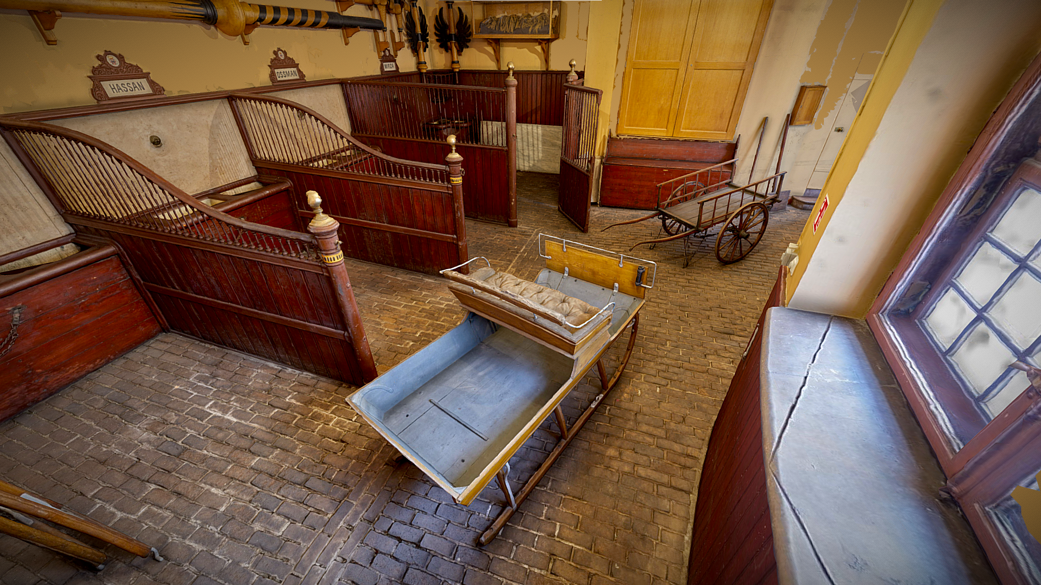

Slide 10
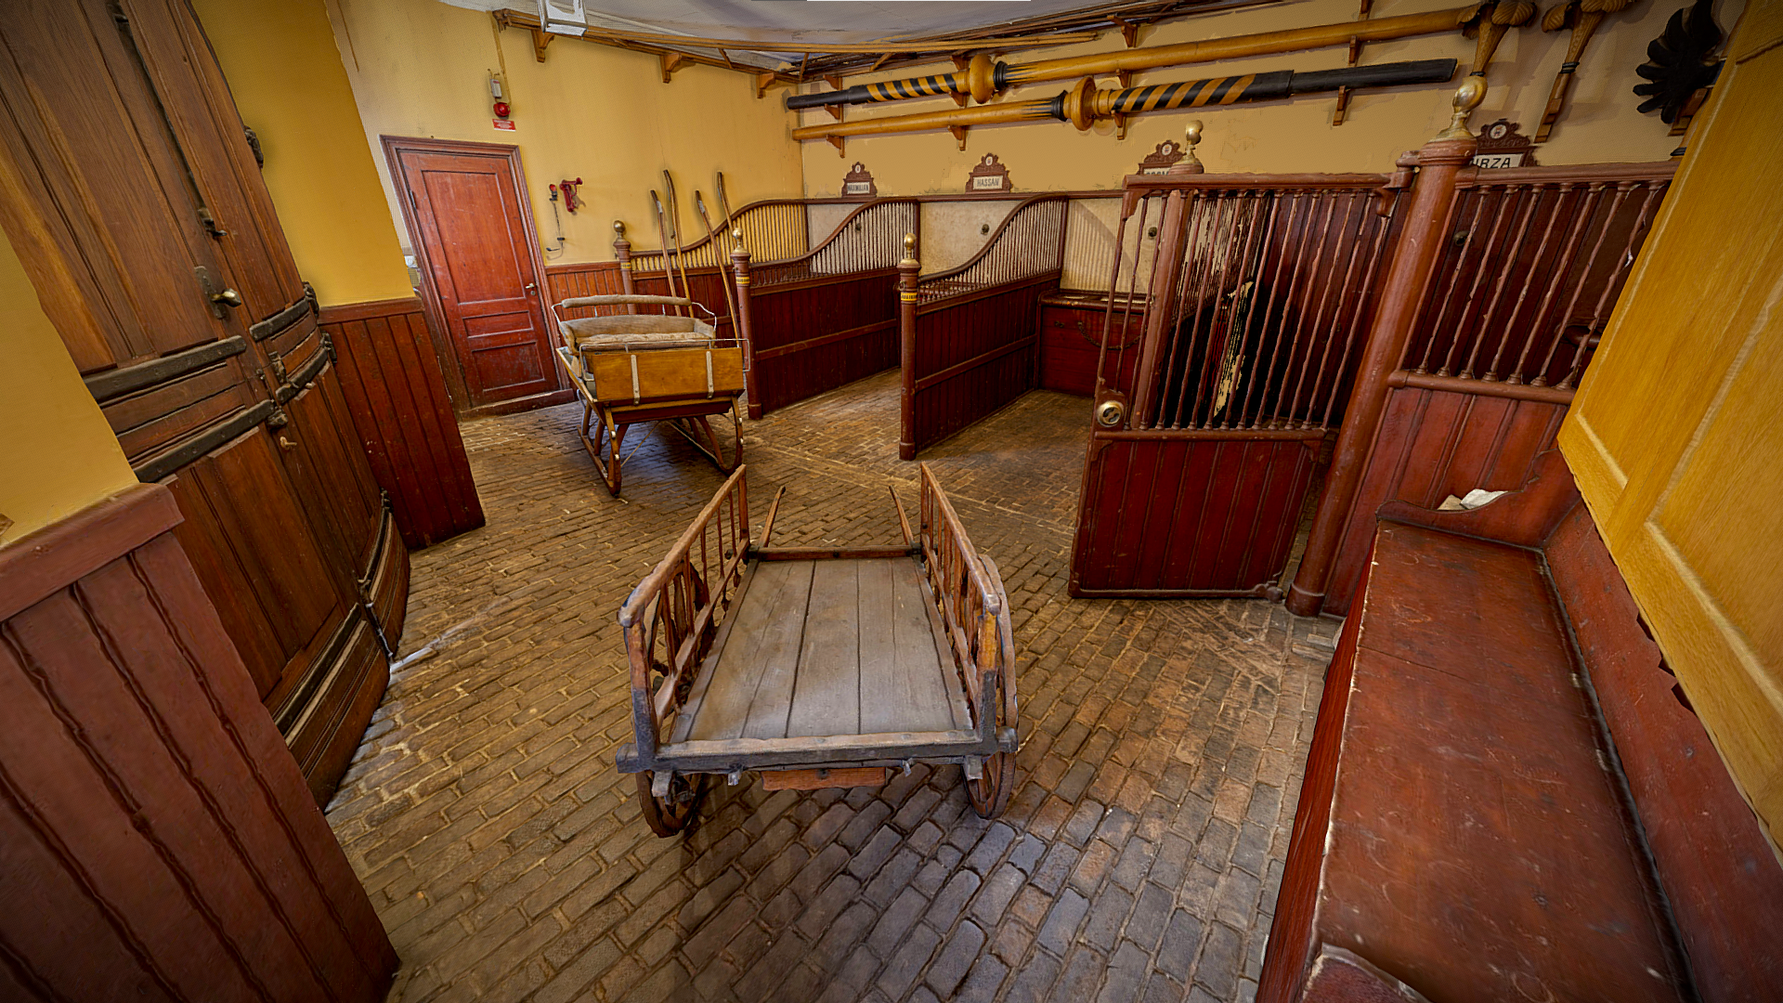

Slide 11
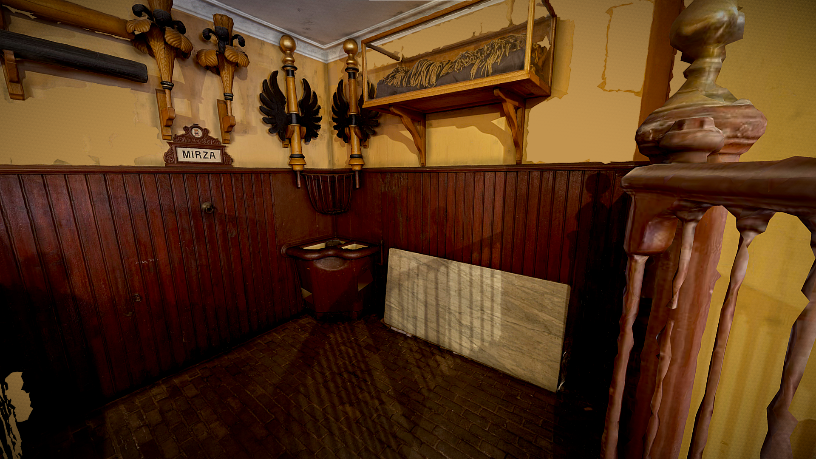

Slide 12
The Armoury
https://sketchfab.com/3d-models/the-armoury-adbe88dcf04d4a87a4c2f62ed6ca0880

Slide 13
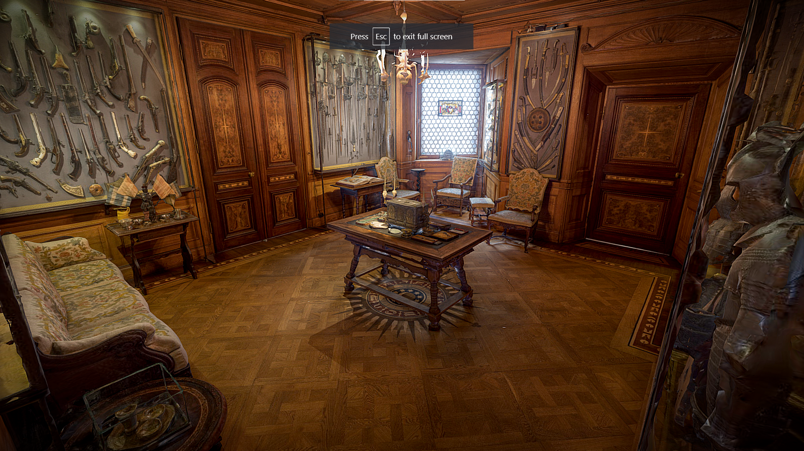
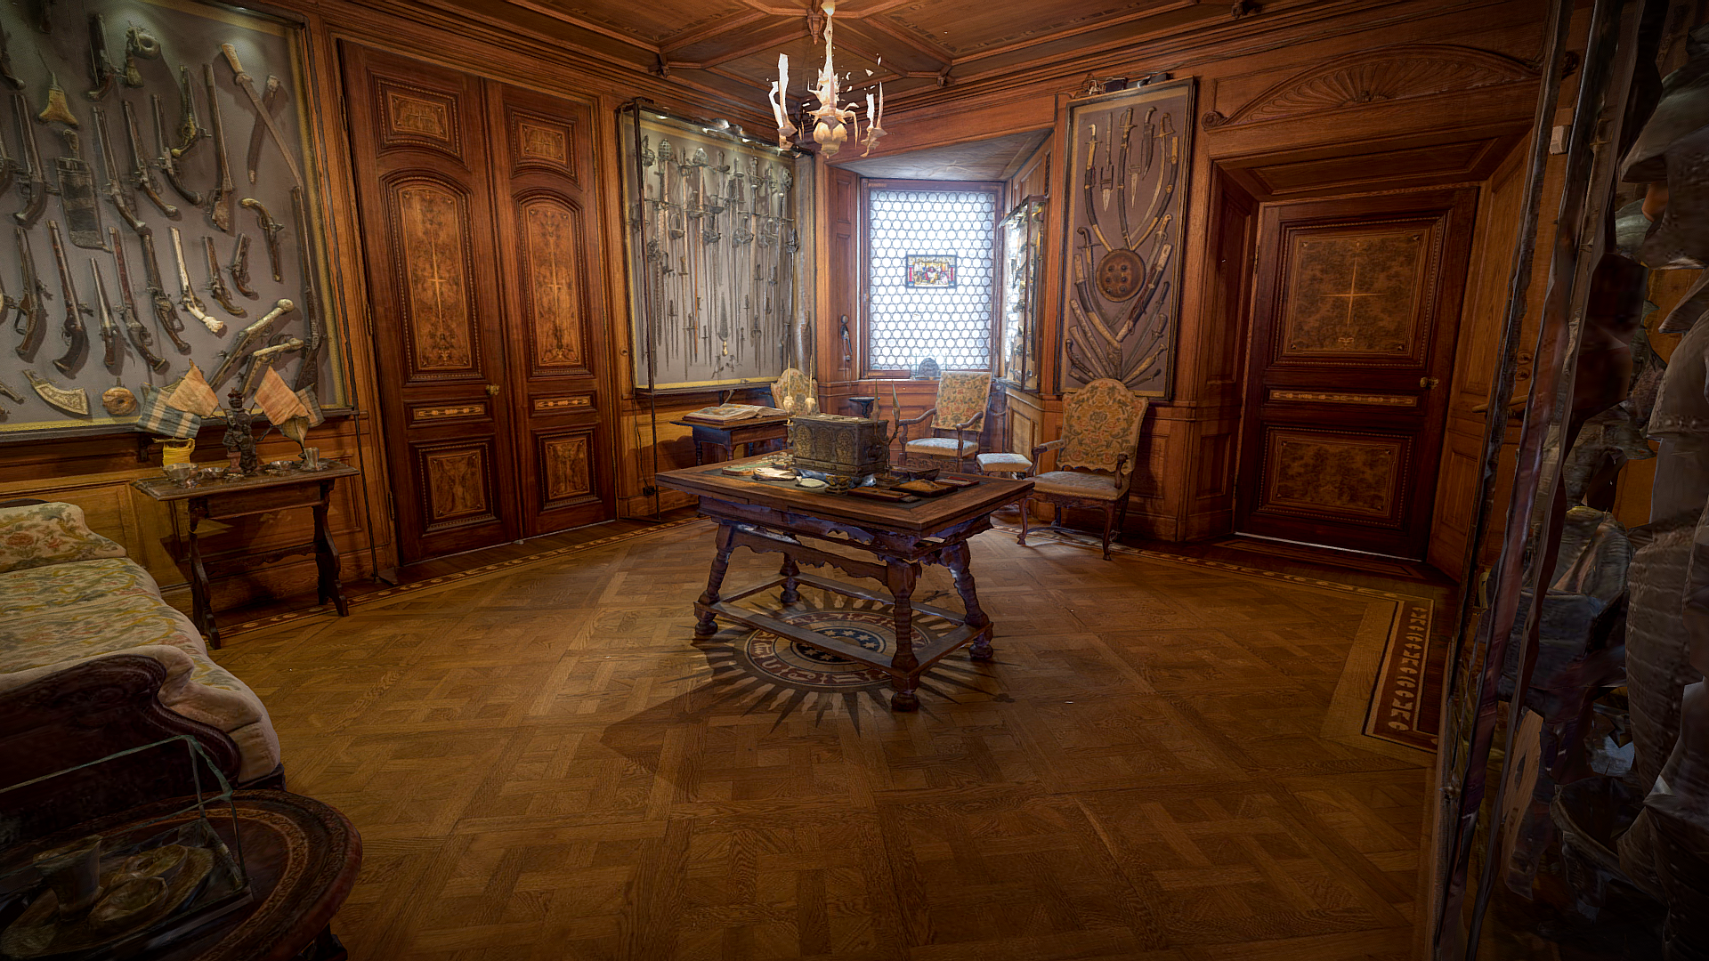

Slide 14
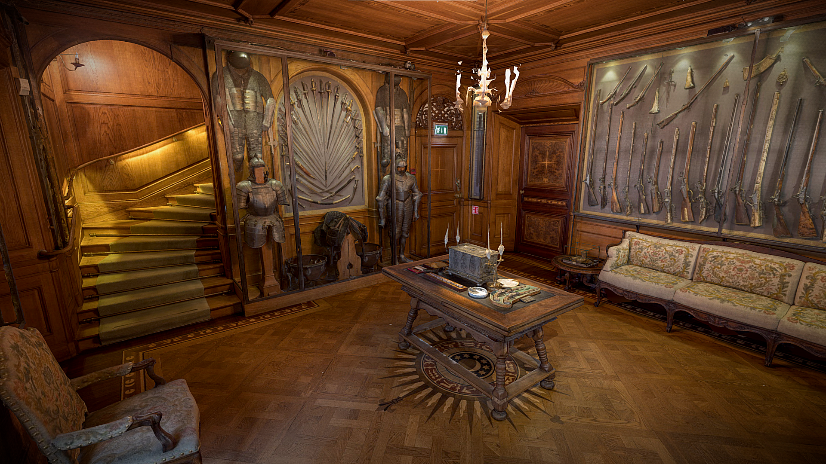

Slide 15
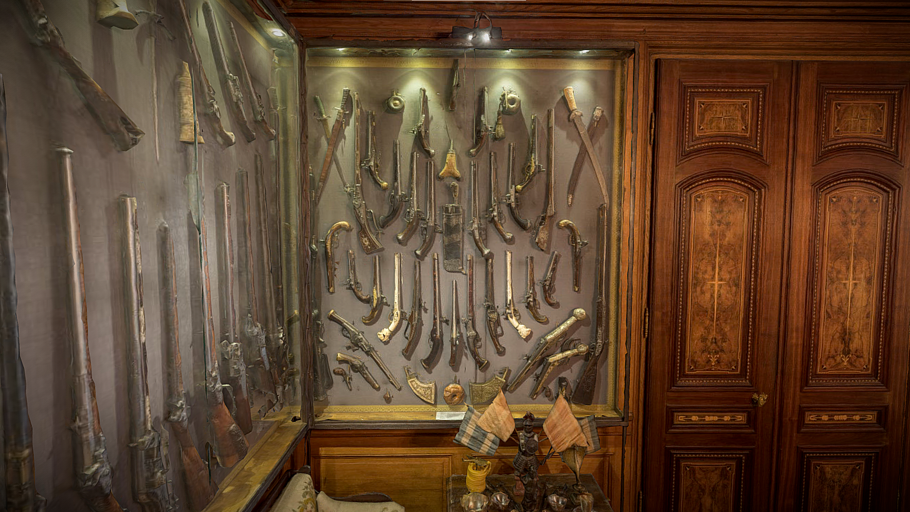

Slide 16
Billiards Room
https://sketchfab.com/3d-models/the-billiards-room-79615d823a9149069dcd06c20bc9707f

Slide 17
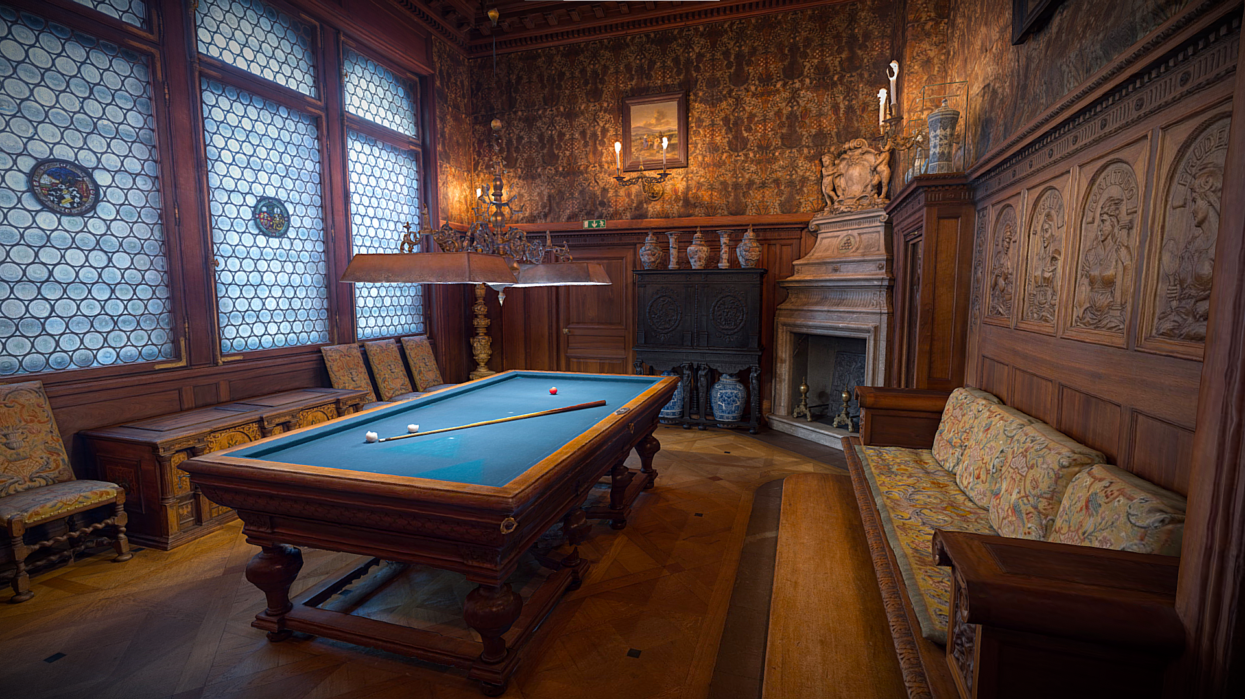

Slide 18
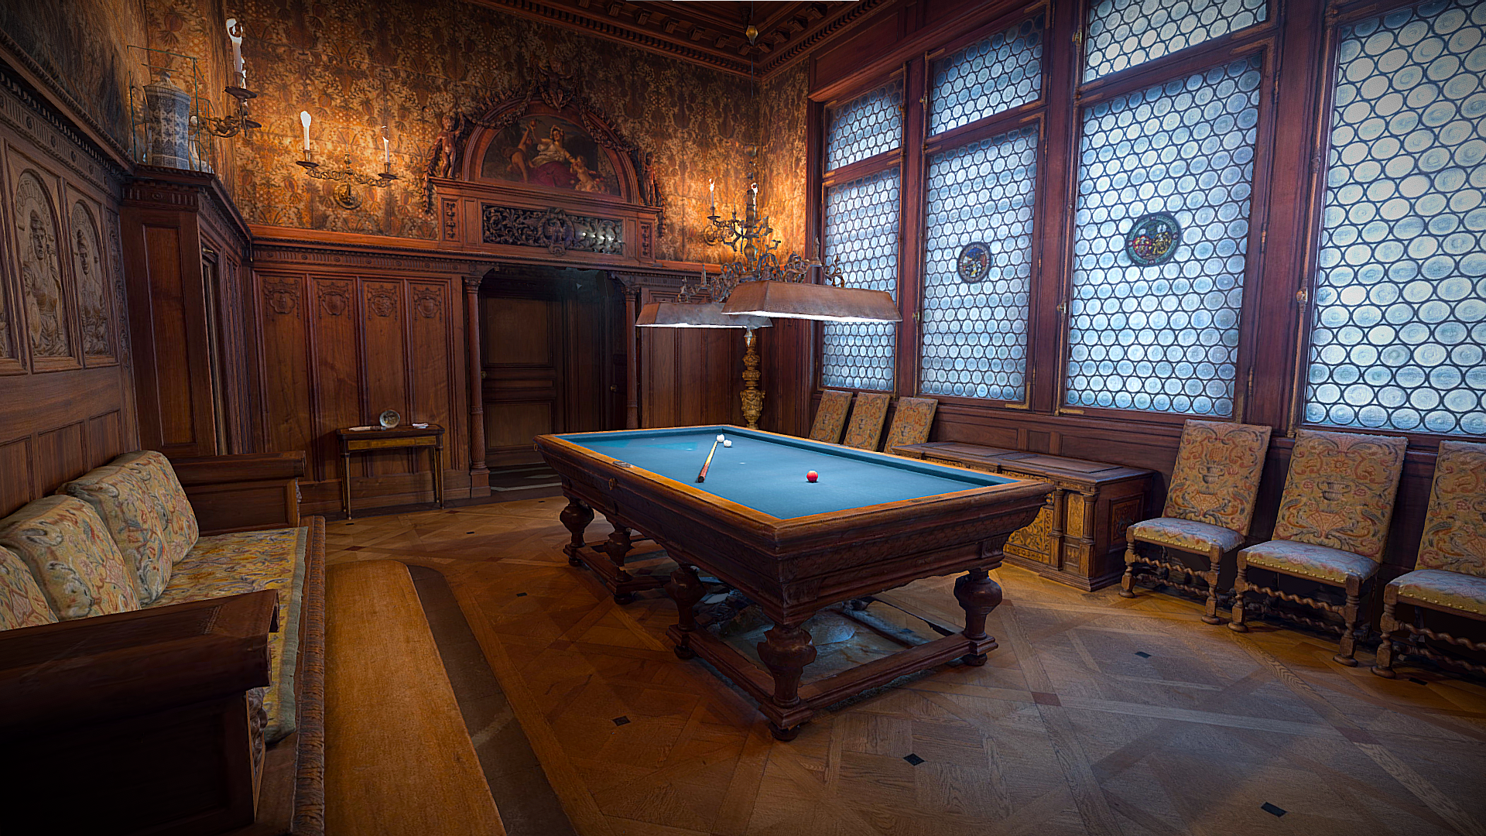

Slide 19
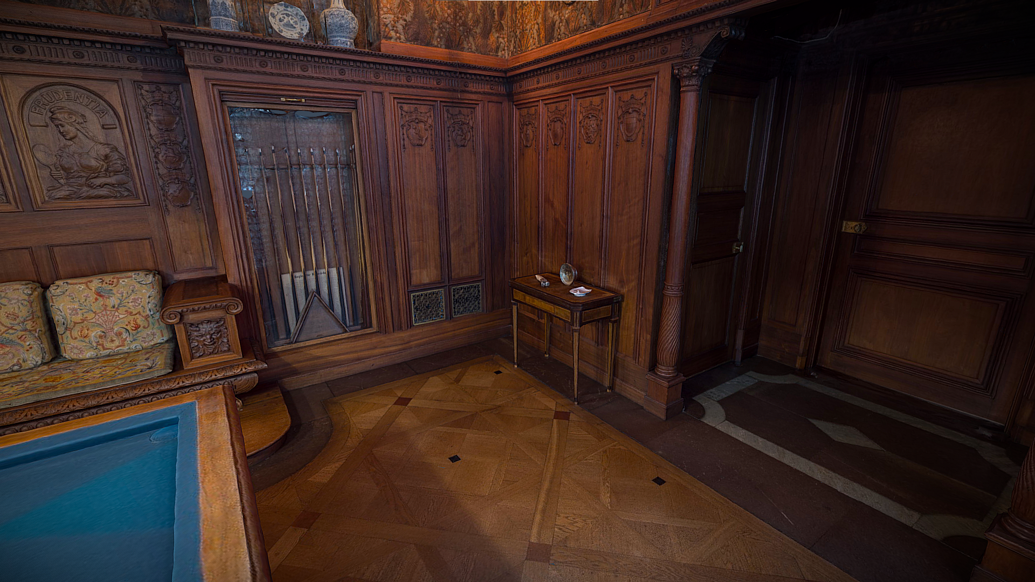

Slide 20
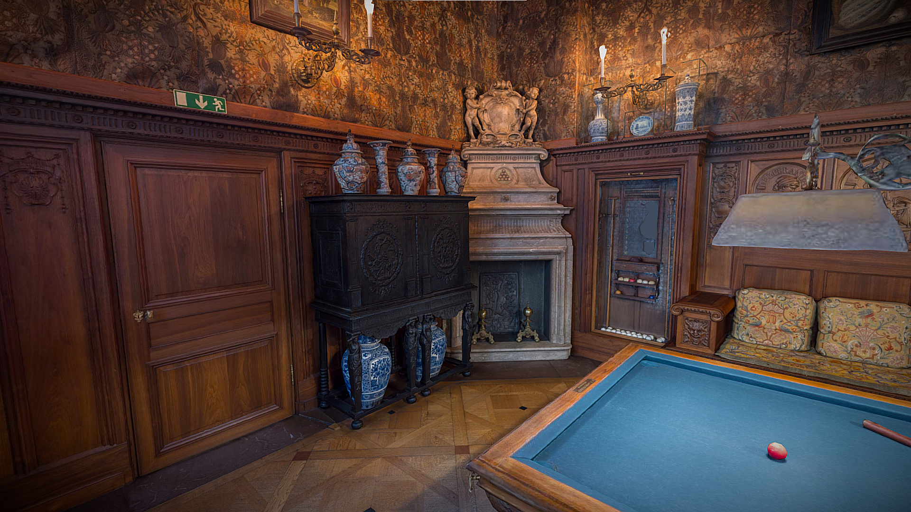

Slide 21
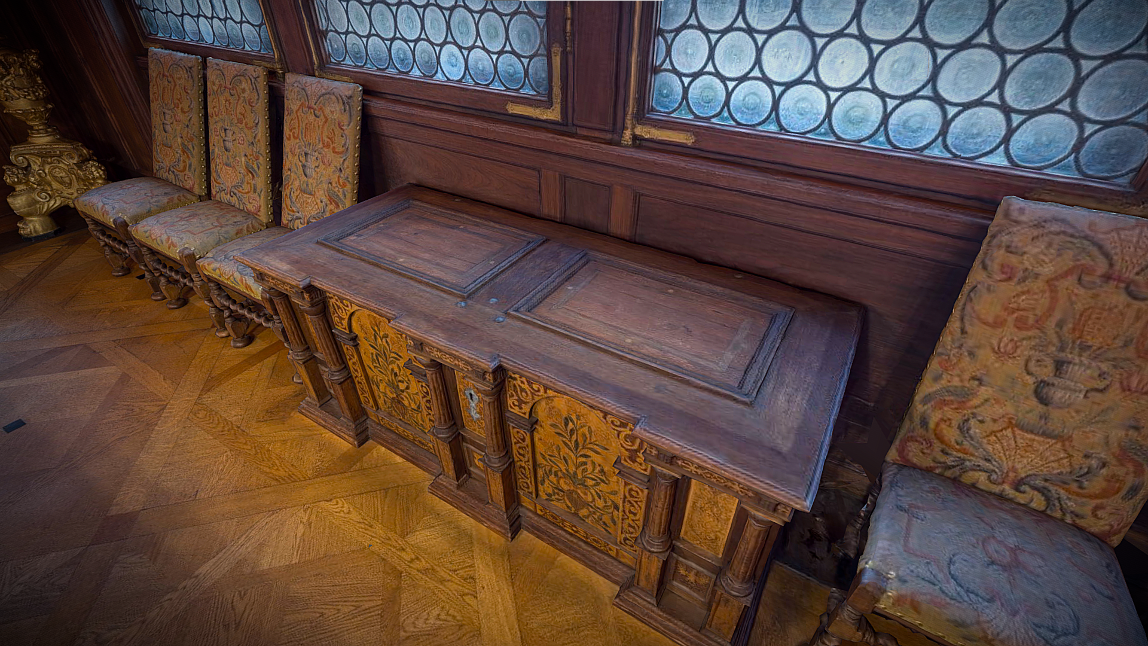

Slide 22
Smoking Room
https://sketchfab.com/3d-models/the-smoking-room-2247ed77976a40b6ae81271cd6b149c8

Slide 23
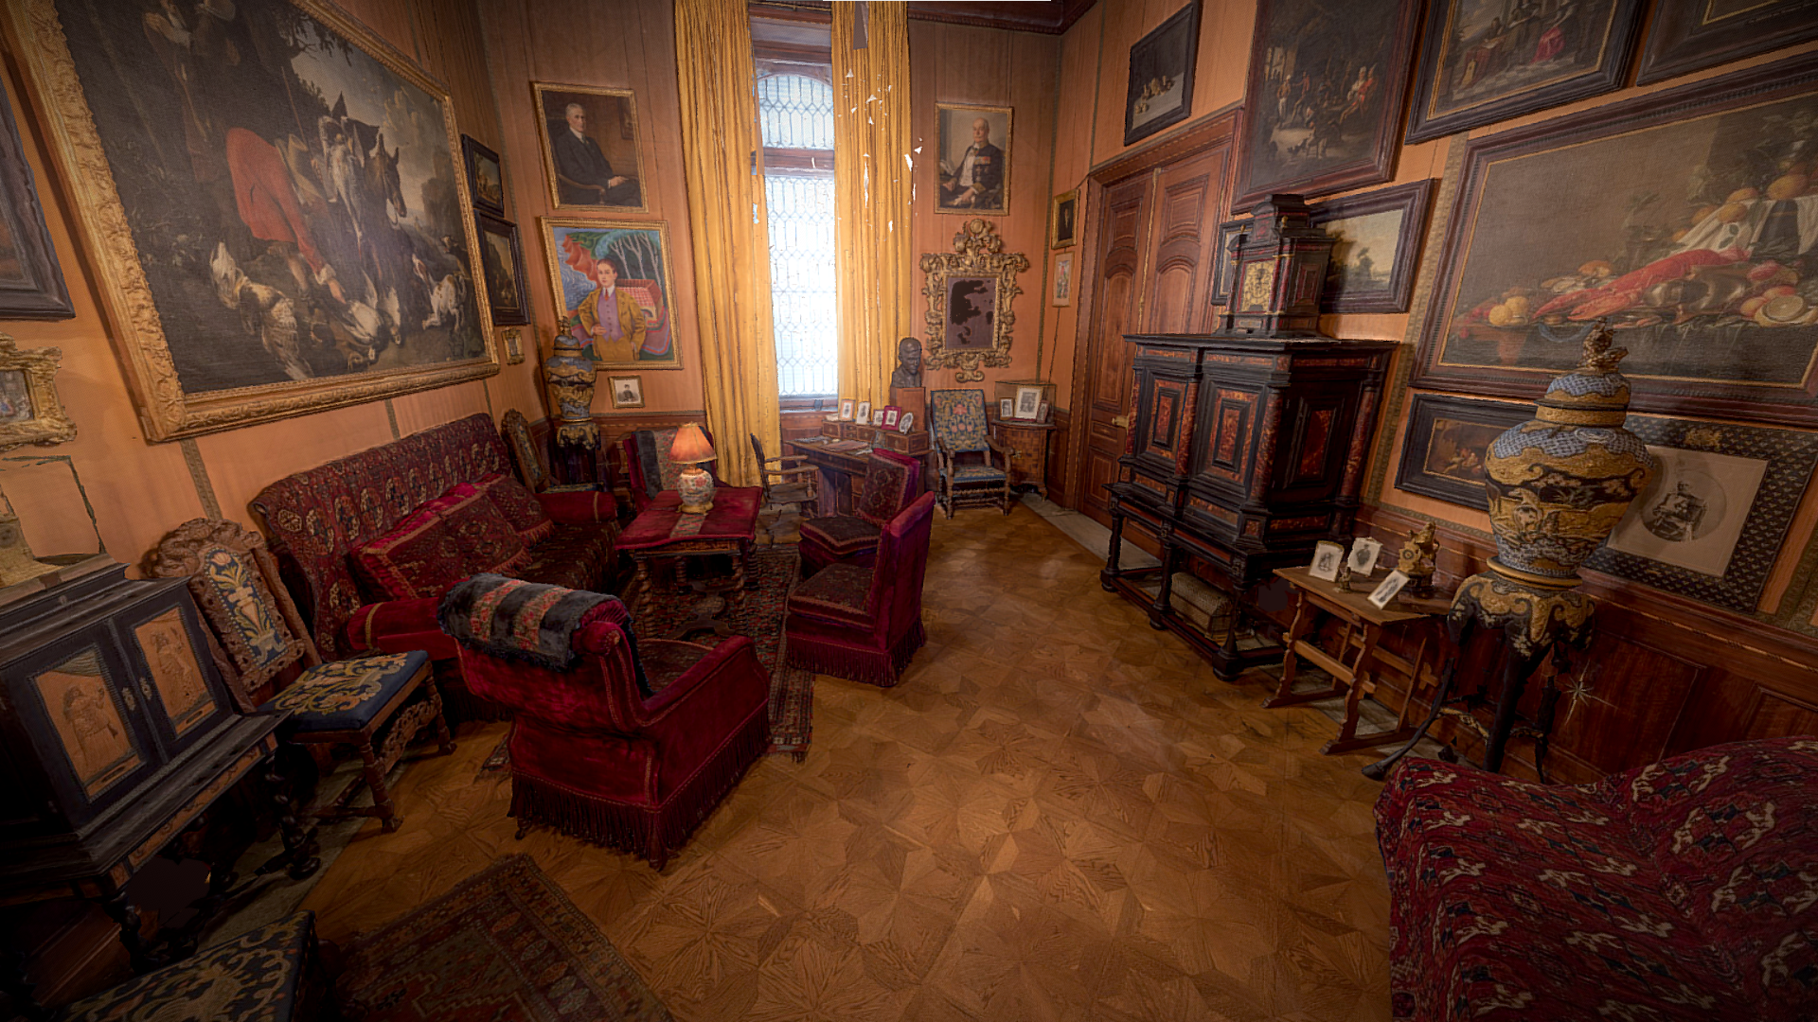

Slide 24
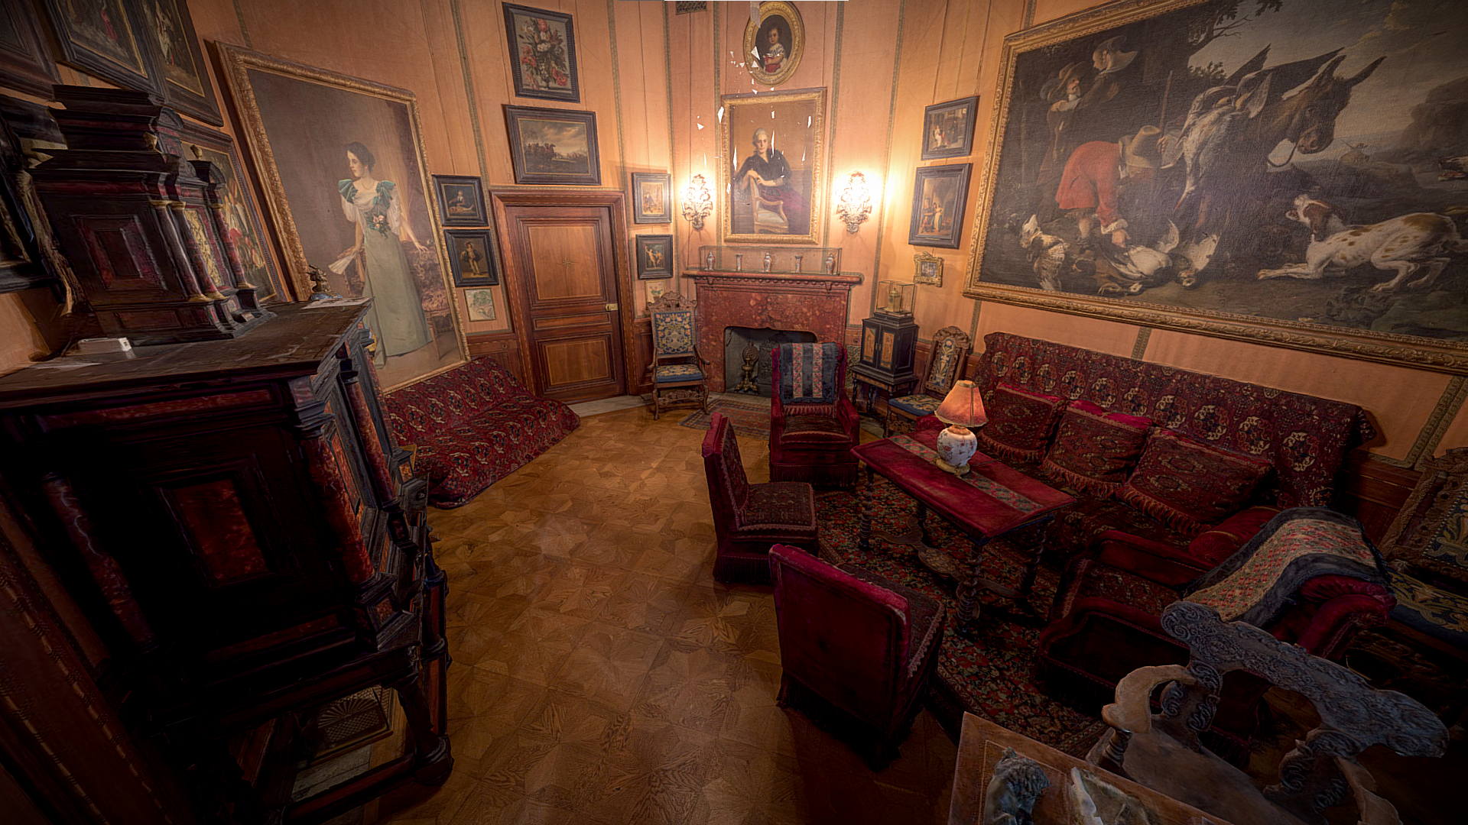

Slide 25
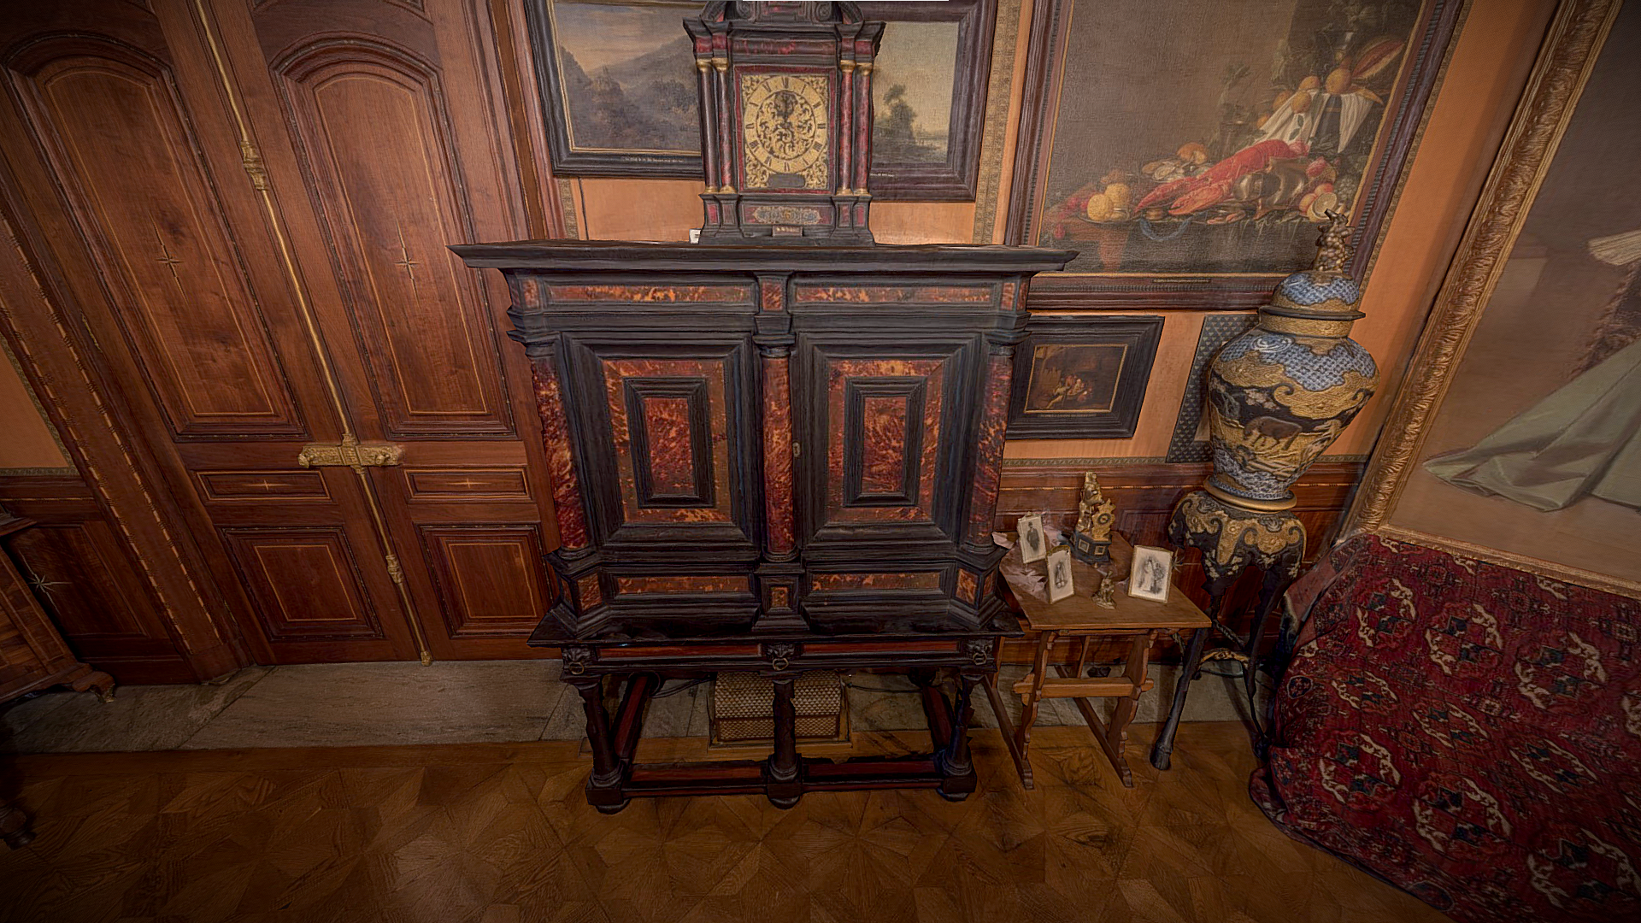

Slide 26
